Slide 1

Exploratory Data Analysis on AMCAT Data

Slide 2
About me
Background:
I am Surya Atrish pursuing B.Tech in Computer Science and Engineering with a strong interest in Python and Data Analytics.
Motivation for Data Science:
Since the start of my undergraduate life, I was deeply interested in Python, its various libraries and frameworks and all the various kinds of problems it can solve. So, I started learning about it, started doing projects. At the same time, I also completed an internship on Data Analytics in Python, SQL Tableau and Power BI. Through research and introspection, I discovered that Data Science resonates deeply with me, offering a perfect fit for my aspirations and skills.
Work Experience:
I am Currently interning at Innomatics Research Labs, transitioning from a computer science and engineering background to data science.
LinkedIn: https://www.linkedin.com/in/surya-atrish/
GitHub: https://github.com/suryaatrish

Slide 3
Agenda
Step - 1 - Introduction -> Give a detailed data description and objective
Dataset Description
Objective
Step - 2 - Import the data and display the head, shape and description of the data.
Describing the data
Data Cleaning
Conversion of Data Types
Collapsing Categories
Feature Engineering
Step - 3 - Univariate Analysis
Continuous Features
Categorical Features
Removing Outliers
Step - 4 - Bivariate Analysis
Barplots
Scatter Plots
Crosstabs
Pivot Tables
Step - 5 - Research Questions
Times of India article dated Jan 18, 2019 states that “After doing your Computer Science Engineering if you take up jobs as a Programming Analyst, Software Engineer, Hardware Engineer and Associate Engineer you can earn up to 2.5-3 lakhs as a fresh graduate.” Test this claim with the data given to you.
Is there a relationship between gender and specialization? (i.e. Does the preference of Specialisation depend on the Gender?)
Step - 6 - Conclusion
Step - 7 - (Bonus) Come up with some interesting conclusions or research questions (such as step-5).

Slide 4
Objective:
The primary objective of the project is to conduct Exploratory Data Analysis (EDA) on the provided dataset, with a particular emphasis on understanding the link between various variables and the target variable, Salary. The EDA process involves:
Identifying and handling missing values, dealing with outliers, and ensuring data consistency and integrity.
Calculating summary statistics (mean, median, standard deviation, etc.) for continuous variables and frequency distributions for categorical variables.
Creating visualizations such as histograms, box plots, scatter plots, and heatmaps to explore relationships between variables, identify patterns, and detect outliers.
Creating new features or transforming existing ones to better represent the underlying data and improve model performance.
Examining the correlations between different variables to understand their relationships and identify potential predictors of employment outcomes.
Investigating the relationships between the independent factors and the target variable (salary).

Slide 5
Description:
The dataset contains information on 3,998 individuals, spanning across 39 columns. Each row represents a unique individual, while each column provides specific details about their employment and educational background.
Key columns include:
ID: A unique identifier for each candidate.
Salary: Annual CTC offered to the candidate (in INR).
DOJ: Date of joining the company.
DOL: Date of leaving the company.
Designation: Designation offered in the job.
JobCity: Location of the job (city).
Gender: Candidate’s gender.
DOB: Date of birth of the candidate.
10percentage: Overall marks obtained in grade 10 examinations.
10board: The school board whose curriculum the candidate followed in grade 10.
12graduation: Year of graduation from senior year high school.
12percentage: Overall marks obtained in grade 12 examinations.

Slide 6
Description:
12board: The school board whose curriculum the candidate followed in grade 12.
CollegeID: Unique ID identifying the college which the candidate attended.
CollegeTier: Tier of college.
Degree: Degree obtained/pursued by the candidate.
Specialization: Specialization pursued by the candidate.
CollegeGPA: Aggregate GPA at graduation.
CollegeCityID: A unique ID to identify the city in which the college is located.
CollegeCityTier: The tier of the city in which the college is located.
CollegeState: Name of States.
GraduationYear: Year of graduation (Bachelor’s degree).
English, Logical, Quant: Scores in AMCAT English, Logical, and Quantitative sections.
Domain: Standardized scores in AMCAT’s domain module.
ComputerProgramming, ElectronicsAndSemicon, ComputerScience, MechanicalEngg, ElectricalEngg, TelecomEngg, CivilEngg: Scores in respective sections of AMCAT.
Conscientiousness, Agreeableness, Extraversion, Neuroticism, Openness_to_experience: Standardized scores in different sections of AMCAT’s personality test.

Slide 7
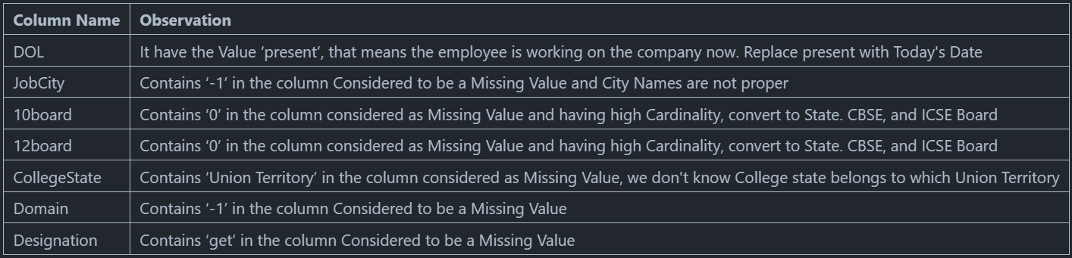
Data Cleaning:
After conducting preliminary assessments on the provided data, it has come to my attention that there are some irregularities present within the dataset.

Slide 8
Describing the data:
Shape: (3998. 39)
Duplicated rows: 0
Columns: 'Unnamed: 0', 'ID', 'Salary', 'DOJ', 'DOL', 'Designation', 'JobCity', 'Gender', 'DOB', '10percentage', '10board', '12graduation', '12percentage', '12board', 'CollegeID', 'CollegeTier', 'Degree', 'Specialization', 'collegeGPA', 'CollegeCityID', 'CollegeCityTier’, 'CollegeState', 'GraduationYear', 'English', 'Logical', 'Quant', 'Domain', 'ComputerProgramming', 'ElectronicsAndSemicon', 'ComputerScience', 'MechanicalEngg', 'ElectricalEngg', 'TelecomEngg', 'CivilEngg', 'conscientiousness', 'agreeableness', 'extraversion', 'nueroticism', 'openess_to_experience'

Slide 9
Feature Extraction:
Since the dataset was release in 2015, we add a age column by subtracting DOB year from 2015. This will add the age as of 2015.
Adding a tenure column by subtracting the `DOL` from `DOJ`
Dropping the rows where the graduationyear is greater than or equal to date of joining
Function to calculate CDF

Slide 10
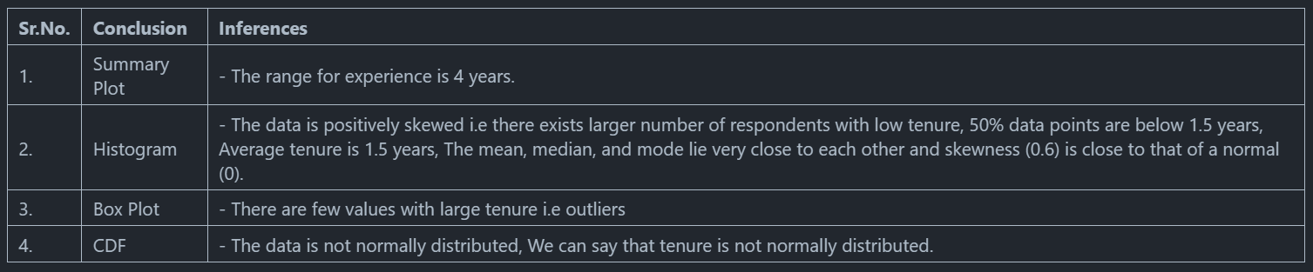
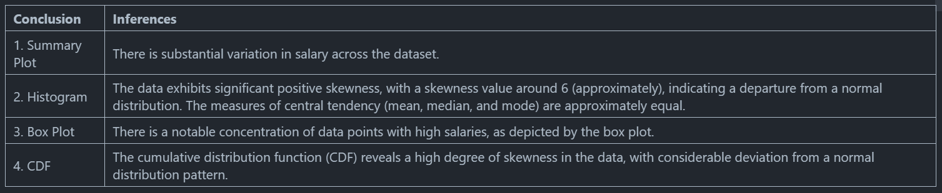
Univariate Analysis:
Continuous Features:
1.1 Tenure
1.2 Salary

Slide 11
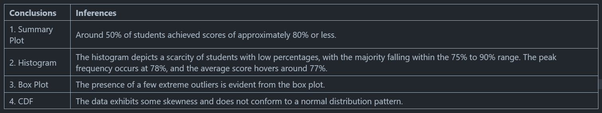
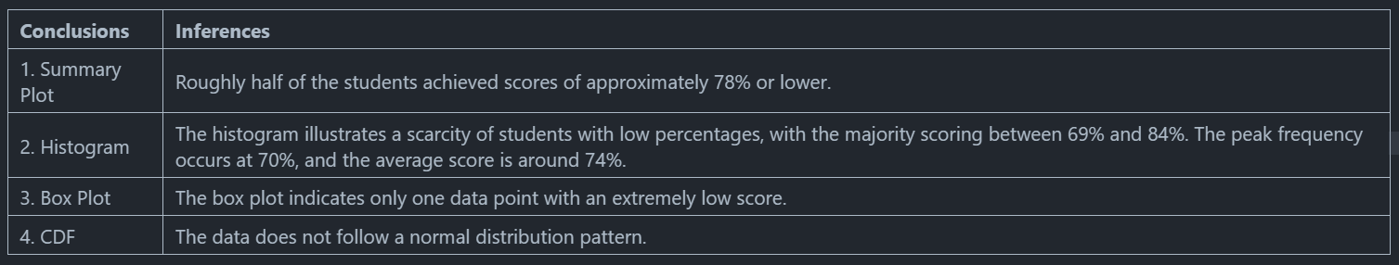
Univariate Analysis:
Continuous Features:
1.3 10th Percentage
1.4 12th Percentage

Slide 12
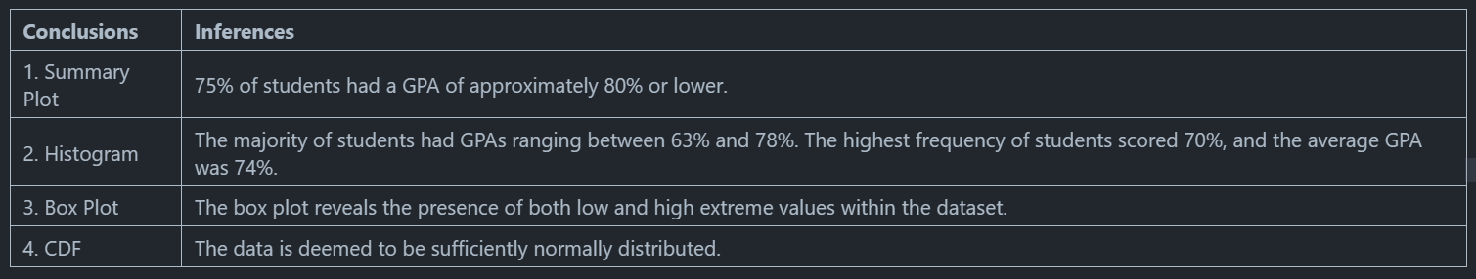
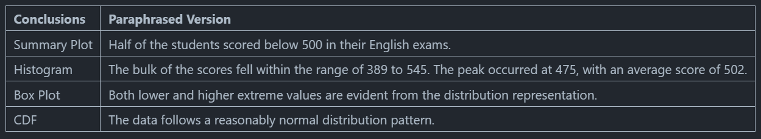
Univariate Analysis:
Continuous Features:
1.5 CollegeGPA
1.6 English

Slide 13
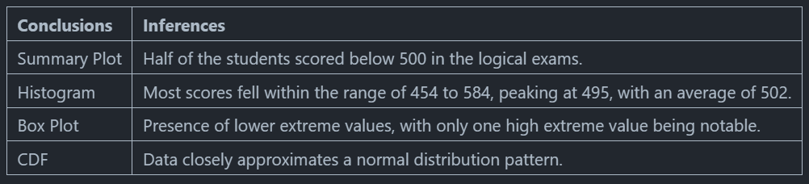
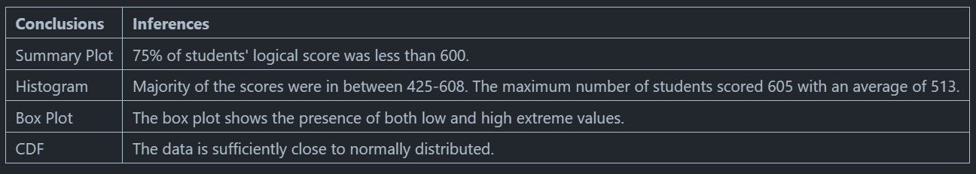
Univariate Analysis:
Continuous Features:
1.7 Logical
1.8 Quant

Slide 14
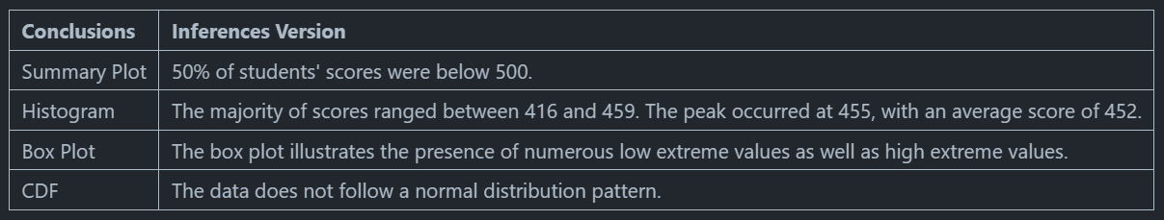
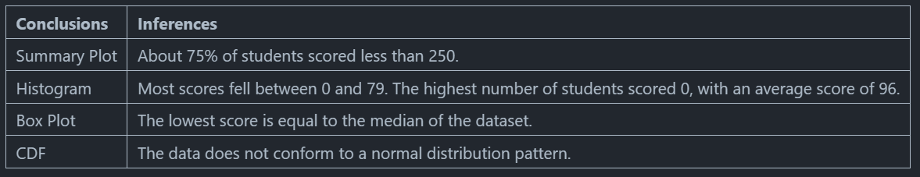
Univariate Analysis:
Continuous Features:
1.9 Computer Programming
1.10 Electronics & Semiconductors

Slide 15
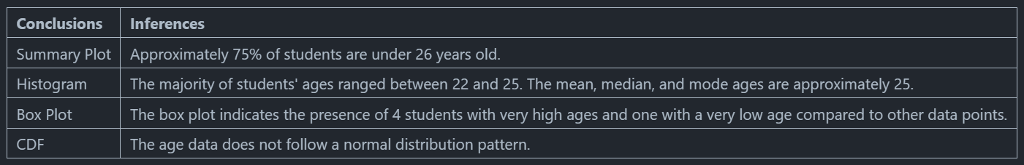
Univariate Analysis:
Continuous Features:
1.11 Age
Categorical Features:
2.1 Designation
Software engineer is the most common desgination of all, followed by system engineer and software developer.
2.2 JobCity
The most favourable city for job placements is Bangalore, followed by Noida, Hyderabad and Pune. Mumbai and Kolkata being least favourable.
2.3 Gender
The dataset is not balanced in terms of gender as the population of Male is really larger as compared to the female one.

Slide 16
Univariate Analysis:
Categorical Features:
2.4 10board & 12board
CBSE is the most common school board for both 12th and 10th.
2.5 CollegeTier
Almost all the college belongs to Tier 1 only with a percentage of 92.5
2.6 Degree
Most of the students have done their graduation in B.Tech and there are very less students from M.Sc(Tech)
2.7 CollegeCityTier
Majority of the colleges are from Tier 0 city.
2.8 GraduationYear
Maximum number of students were graduated in 2013, followed by the year 2014 and 2012.
Removing Outliers:
Number of observation with outliers: 3864
Number of observations without outliers: 2490

Slide 17
Bivariate Analysis:
Bar Plots:
1.1 Average Salary for each Designation
Bar plot shows the maximum salary for each Designation. Senior Software Engineer has the highest salary but they also has the maximum standard deviation in their salary. There are only two designations namely, software developer and technical support engineer who has salary lower than average salary.
1.2 Average Salary for each Gender
The average salary for both male and female is approximately equal and it implies that there was no gender bias in terms of salary. It is also plausible to say that Female's get salary below the overall average salary.
Scatter Plots:
2.1 Salary & 10th score
There does not exist any correlation between Salary and 10th scores.
2.2 Salary & 12th score
There does not exist any correlation between Salary and 10th scores.
2.3 Salary & CollegeGPAscore
There does not exist any correlation between Salary and CollegeGPA scores.

Slide 18
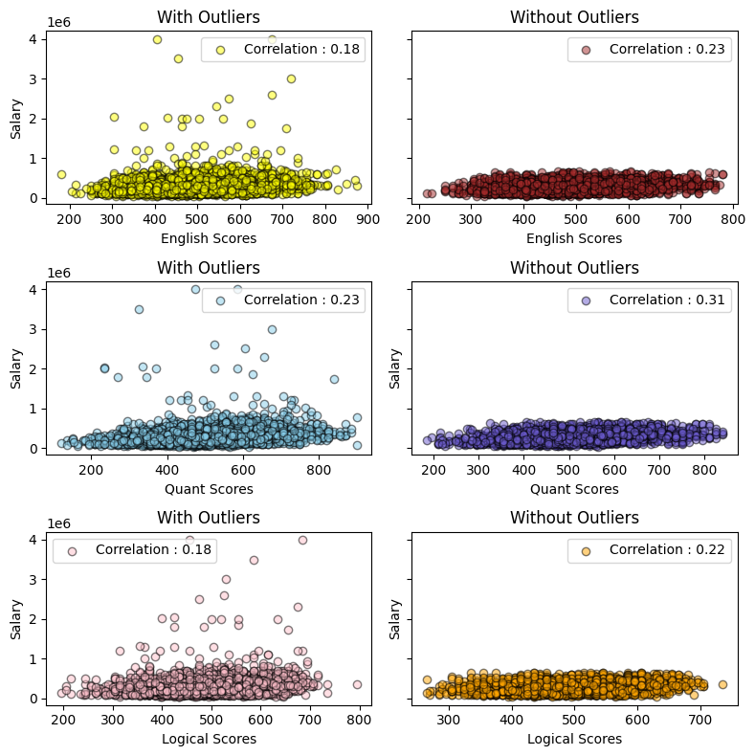
Bivariate Analysis:
2.3 Salary & Age
After removing the outliers, it is evident that the salary and age are not related to each other.
2.4 Salary & Tenure
After removing the outliers, it is evident that salary gets about 50% of increment as tenure increase as there is a positive correlation of 0.60.
2.5 Salary with English, Quants & Logical
On the right.

Slide 19
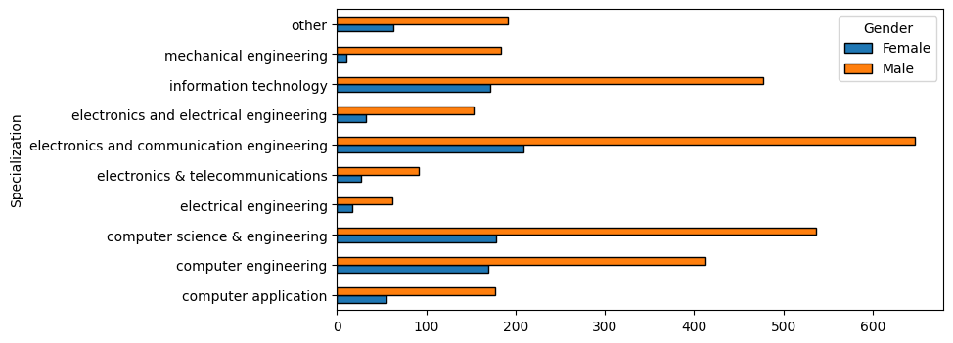
Bivariate Analysis:
Crosstab between gender and specialization:
There are almost males 2 times as of females in every specialization. Also, there are very less number of females who opted for mechanical and electronics.

Slide 20
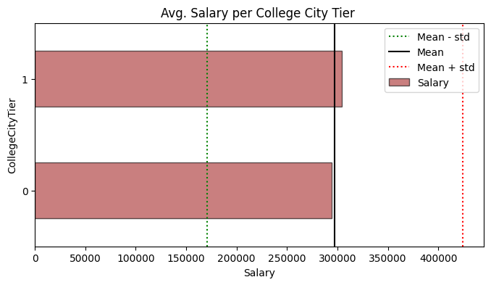
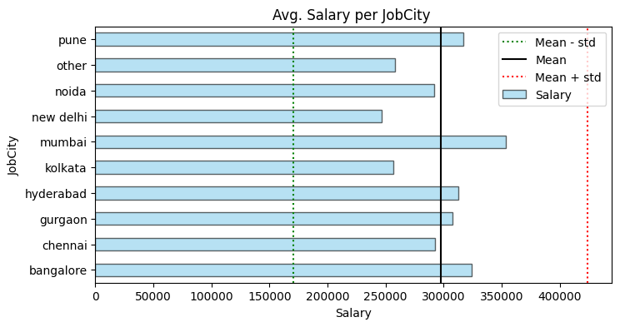
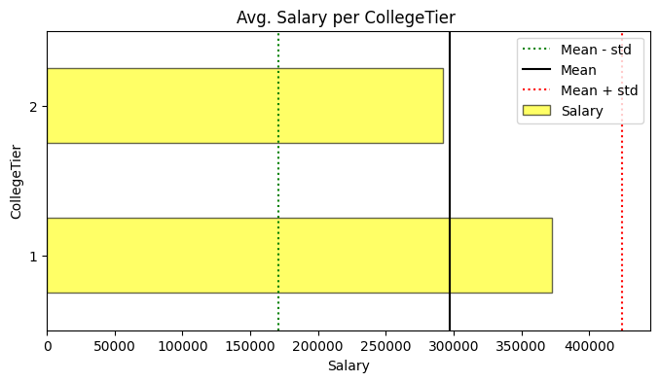
Bivariate Analysis:
Pivot Tables:
Cities under Tier 1 and 2 offers almost same salaries to students.
College within Tier 1 offers high salary as compared to the colleges in TIer 2. Colleges in Tier 2 offers below overall average salary.

Slide 21
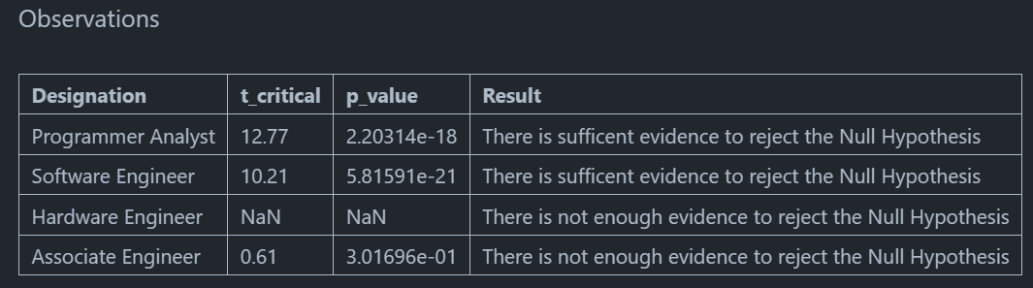
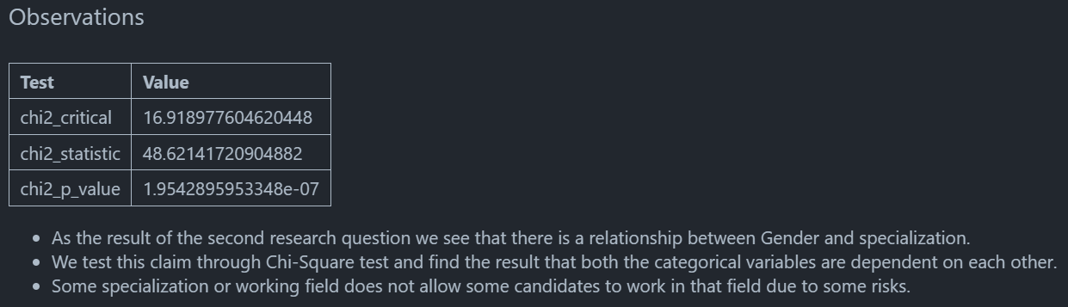
Research Questions:
Data Overview:
2. Data Preparation:

Slide 22
Conclusion:
1. Data Overview:
- Within the dataset, the focus lies on exploring the employment outcomes of engineering graduates, with particular attention to the target variable "Salary". Additionally, it encompasses standardized scores representing cognitive, technical, and personality skills.
2. Data Preparation:
- Initial scrutiny reveals a dataset comprising 3998 rows and 39 columns.
- To refine the dataset, redundant rows and columns are eliminated to ensure data efficiency.
- The mitigation of missing values (NaN) is prioritized to uphold data integrity.
- Post-cleaning, the next step involves visualization.
3. Data Visualization:
- Univariate Analysis:
- Univariate analysis encompasses various plots such as Cumulative Distribution Functions (CDF), Histograms, Box Plots, and Summary Plots.
- These visualizations effectively illustrate probability and frequency distributions.
- Bivariate Analysis:
- Bivariate analysis incorporates Scatterplots, Barplots, Crosstabs, Pivot tables, and pie charts.
- It facilitates the comparison of percentages across variables and the identification of outliers, prominently showcased through Boxplots.
- Countplots are particularly useful in pinpointing outliers within categorical variables like Job City, offering insights into cities with significant employee counts.

Slide 23

THANK YOU

